Slide 1
Writing a good proposal
Your proposal is your best advertisement

Slide 2
Writing a good proposal
1. Golden rule: "Start as early as possible!"
2. Focus on quality: you should focus on a few number of applications. A big number of applications will decrease the quality of your work. Having an outstanding proposal is extremely important.
3. Get involved in the project:
Subscribe to the mailing list, ask and answer questions,
Read any introductory documentation and get familiar with the source code of the project and the coding style.
Introduce yourself to the community.
Add simple features to the project, fix simple bugs and do some early-code-hacking.
Send some patches and get feedback.

Slide 3
Writing a good proposal (cont.)
4. Discuss your idea:
If you have an idea of yours, you need to discuss it to prove its feasibility and to know if your idea relevant to the project ? what are the milestones ?
Get feedback about your idea, this feedback is crucial to your application, the project developers can help you adjust the required time for each milestone and whether you can do the whole work during the Google summer of code or not, sometimes students are very optimistic :),
Discuss some technical details, how will you test your application ? how can you use the project test suite to test your work ? do you have to write your own tests ?
Establish priorities, what should be delivered by the end of GSoC and what is optional ? Make sure that you can achieve the goals you set. It’s better to write a small but reliable, easy-to-read and well documented code than to write a huge buggy, non-readable code. Quality is important.

Slide 4
Writing a good proposal (cont.)
5. Write your proposal:
Describe precisely your idea:
The idea itself,
What are the benefits for the project ? why is it important ? what bugs will it fix ?
Technical/Implementation details: this shows that you have a clear idea about what you want to do,
Describe the possible problems that you may encounter and how you plan to solve them ?
Pictures: If you can add some mock-ups to show how your project will look like.
Timeline, Include a detailed schedule of your work: when will you do what ?
A CV-like section:
Showing that you have already worked on a similar project helps a lot.
Beside your “good” CV, it would be really nice to show that you are familiar with the project, that you have already contributed some patches, and that you are ready to be productive.
And sure your contact information.

Slide 5
Writing a good proposal (cont.)
6. Submit your proposal early:
keep it short but include all the necessary information. Get it reviewed by the right people in the organization, well before submitting it to the Google Summer of Code web application.

Slide 6
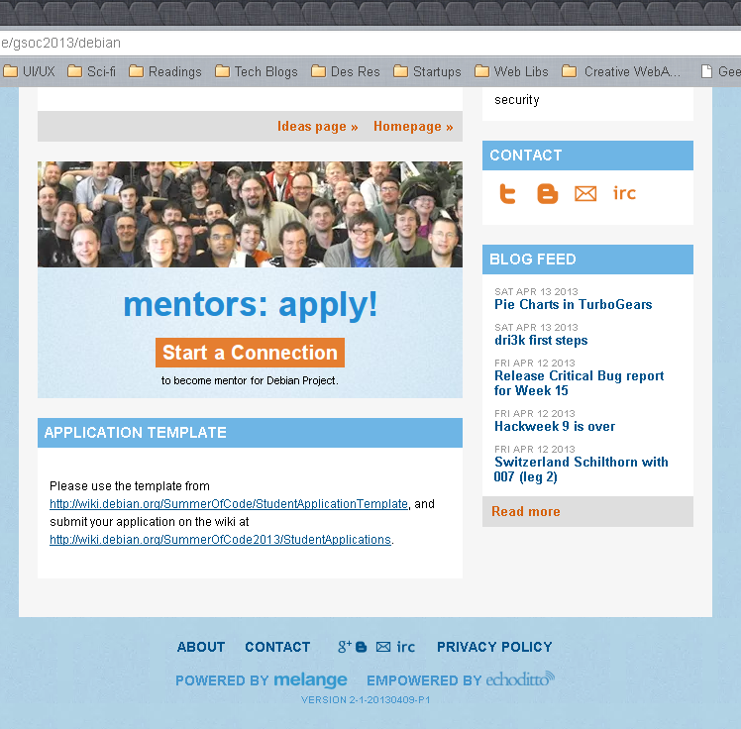
Proposal Template
Follow your organization proposal template, you will find it usually in their page on Google Melange

Slide 7
My Proposal
Here is my last year proposal:
http://goo.gl/rYBgo

Slide 8
References
Helpful Articles:
http://goo.gl/EKPBA
http://goo.gl/P2v5q
Useful Links
http://goo.gl/2vLy8
http://goo.gl/lWbDa
http://goo.gl/wk5P5
Accepted Proposals from previous years:
http://goo.gl/EvyrX

Slide 9
Good luck :)

